Slide 1

Nature and extend of barriers to accessibility in electoral participation of PwDs
January 2018

Slide 2

“We have a moral duty to remove the barriers to participation, and to invest sufficient funding and expertise to unlock the vast potential of people with disabilities.” by Stephen Hawking

Slide 3

Article 29 – CRPD
States Parties shall guarantee to persons with disabilities political rights and the opportunity to enjoy them on an equal basis with others

Slide 4
Legal Provision
Section 323 of Election Act of Kingdom of Bhutan, “Election Officer shall provide all necessary assistance to the physically challenged, such as the blind, physically handicapped, illiterate, or those living in remote areas to enable them to exercise their right to vote effectively.”

Slide 5
Implementation of Section 323 of the Election Act
3. Voter Awareness
1. Physical Assistance
Responsibility of Election Officers
2. Preferential Access
4. Special Considerations
Notes:
PO must offer all possible assistance to voters. Get assistance in the voting compartment
PO ensure that a PwDs are given preferential treatment by not having to wait in the queue or face other avoidable impediments
special attention to increase their awareness of the political process and enhance their ability to exercise their right
Special arrangements shall be made to support Remote Area Voters

Slide 6
Background
Discussion at all level – on PwDs
Policies on PwDs – formulate
Bhutan – a late entry to the institution of voting and democracy
Advantage - Act, Rules and Regulations and Guidelines
Population - 7, 50,000
Little over 400, 000 voters
Still faces challenges

Slide 7
PS - schools, hospital, govt. buildings – without facilities
Polling Station – Accessibility
Inhospitable geographic terrain of the country
Home – not friendly
Road connectivity – No house connectivity

Slide 8
Registration drive in full swing
Mobile PB – delivered to Pwds, hospital patients and prisoners
Good news - 2018 Parliamentary Elections
Positive – PwDs will make their choice
Temporary measures – hope soon time will come they proudly participate without external assistance
Intervention

Slide 9
Recently collected data
Male | Female | Total | Registered &Voted | Registered Not Voted | Not Registered | Total | % of voter turnout
2083 | 1708 | 3791 | 1804 | 911 | 1101 | 3816 | 66.5%

Slide 10
Discrimination/ Attitudinal Barriers
Social stigma - avoid embarrassment
Ostracized from the social and community engagement - barrier in everyday life
Negative attitudes - biggest challenge
Superstition belief - impairment is a karmic consequence of the person’s past life

Slide 11
1. Advocacies – ECB, CSOs and govt. agencies
4. Inclusion of PwDs plan - 12th FYP
Intervention
2. Royal patronage of ABS - making a strong presence
3. Govt’s initiatives for policy on disability

Slide 12
Awareness
Every vote counts. Voter Education important for EMBs
PwD focused awareness as of now are not carried out fully
Lack of capacity and low and scattered population of PwDs
Disabled People Organizations are new and lack the ability
Communication barrier – visual, physical, intellectual, hearing and speech impairment

Slide 13
Intervention
Reaching out to PwDs is a tough task
2018 is an election year - comprehensive strategies
Each District - customize plan to suit the local needs
Awareness village level – individual attention to PwDs
Diverse methodology for the voter education
Social media and engagement of youth
Notes:
5. lecture, animations, theme songs, brochure, and advertisement in print media, television and radio
6. Social media and engagement of youth through Democracy Clubs, Children Parliament, and Celebrities in street shows and inspirational video clips from the speeches of the His Majesty the King are other techniques

Slide 14
Conclusion-Political participation is the cornerstone of democracy
HLTF – Recommendation & Partnership Building
12th FYP
Disability Policy
Strengthen Accessibility to voting and materials
Awareness on rights and duties
Research and data

Slide 15
NOTE:
Studies show that people with disabilities are interested in government and public affairs and want to participate in the democratic process. But because they are often locked out of the polling stations they stay home on election day

Slide 16
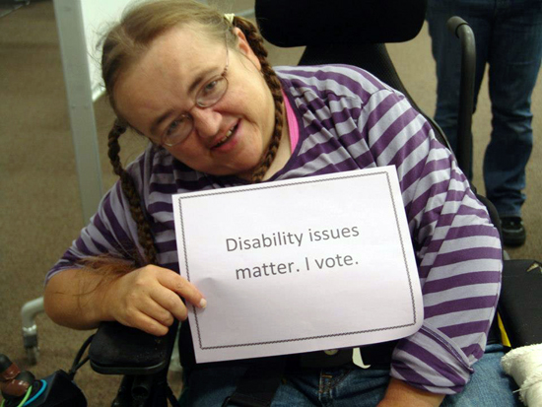
THANK YOU

